Slide 1
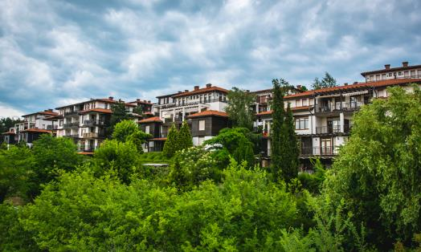
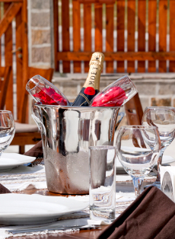






2006
FairPlay Properties Management and the FPI Hotels & Resorts brand were established to inherit FPI`s hospitality portfolio and grow the initial investments into a prosperous brand.
Property and
hotel management
www.fpihotels.com
Business in three main directions:
  Hotel & Resort maintenance
  Property & Rental Management
Operating in Sofia, Bansko and Sozopol

Slide 2
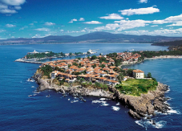
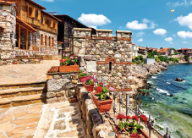
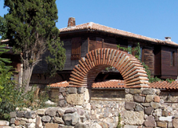

    Sozopol, Black Sea Coast
The oldest town on the Bulgarian Back Sea coast, dating back to 610 B.C.
Sometime in the 4th century, Apolonia is said to have accepted Christianity and, as many other cities named after Apollo, adopted the name Sozopolis, meaning ‘salvation city’
During the Middle Ages the town was the biggest fishing city on the Bulgarian Black Sea coast, while developing and eventually realizing its tourism potential
During the National Revival Period, the town was rebuilt with typical houses made of stones, white plaster external façades, wooden coatings and red tile roofs
More than 2 600 years of history, there are relics of different periods and cultures to be seen: Greek-Roman monuments dating back to the Antiquity and architectural monuments from the Bulgarian Renaissance
Resorts

Slide 3
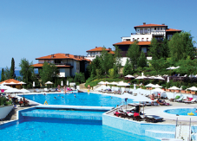
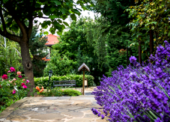
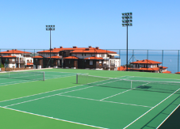

    Santa Marina Holiday Village
80 three-storey and four-storey villas with 1300 modern,
comfortably furnished and fully-equipped studios and
apartments with one and two bedrooms and sunny terraces.
  4 restaurants /Mediterranean, Asian, Balkan, Pizzeria/
5 pools, 4 kids pools, 2 beaches
  3 pool bars and 2 beach bars
2 wellness centers and a hairdresser salon
Kids club & animation team
2 grocery shops, clothing, cosmetic, sports and other shops
Medical center and pharmacy
8 GreenSet® tennis courts, fitness hall and a mini soccer field
Beach volleyball court
Water sports
Conference facilities for up to 100 people
Travel & tourism services
Reception desk
Real estate office
Resorts
www.santamarina.bg

Slide 4
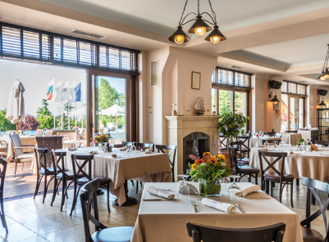
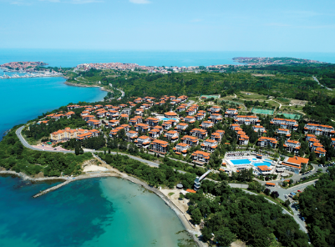
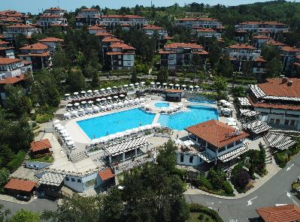
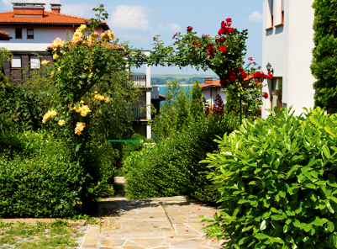
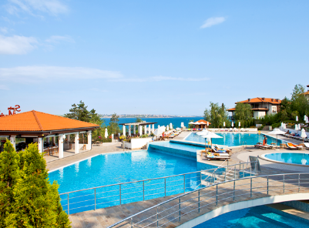
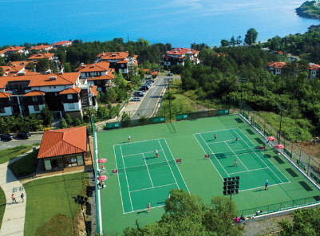
    Santa Marina Holiday Village

Slide 5
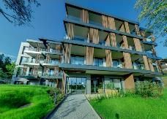
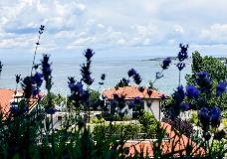

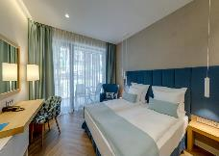
    Viva Mare Beach Hotel
Viva Mare Beach Hotel is the newest hotel in Sozopol and the long-awaited addition to the unique Santa Marina Holiday Village.
In the southern part of the village, 50 m. from the beach of Marina Beach Bar and just a 15-minute walk to Sozopol’s old town
68 smart modern rooms
2 studios
10 highlight rooms
All rooms offer modern intelligent solutions combined with luxury, comfort and wonderful views of the surrounding park and the sea
All Inclusive concept
Hotel guests are entitled to use all facilities in Santa Marina Holiday Village and Marina Beach Bar
Resorts
www.vivamaresozopol.com

Slide 6
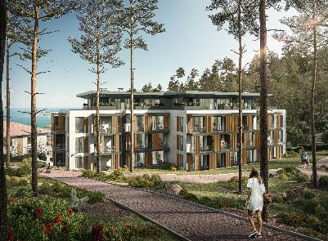
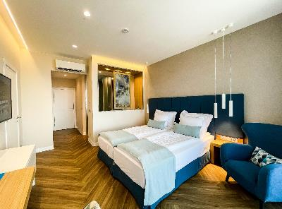
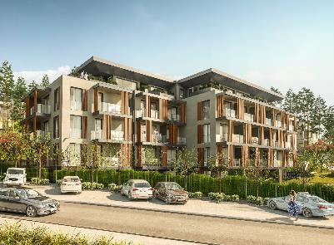
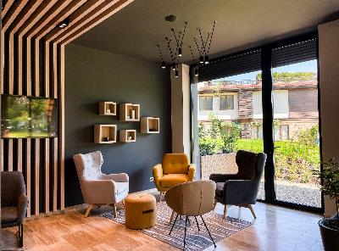
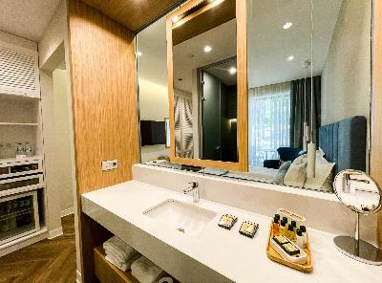
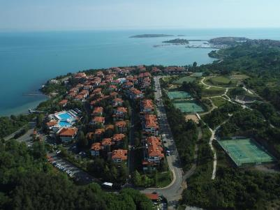
    Santa Marina Holiday Village

Slide 7
FAIRPLAY properties management
WWW.FPIHOTELS.COM

